Slide 1
Naveed Iqbal
Tv instructor
Department of mass communication
Lahore college for women university Lahore
&
Director production Apna TV network

Slide 2
What producing is all about
Idea to presentation process
Task on time and within budget

Slide 3
Major steps in TV production
Preproduction planning
Preproduction planning (coordination)
Production
postproduction

Slide 4
Preproduction planning
Program idea
brainstorming (breaking conceptual blocks)
clustering(structured way generating ideas)
organizing ideas (angle the idea)
Production model
Idea
Defined process message
Production
Medium requirements
Content
People
Equipment
Actual process message
Feed back
Program proposal
A Written document that stipulates what you intent to do

Slide 5
Preproduction planning (cont..)
Program title
Short but memorable
Program objective
Target audience
Demographics
Gender, ethnicity, education, income level, house hold size
Religious preferences, geographical location (urban or rural)
Psychographics
Buying habits, values,& lifestyle
Show format
Production method
Budget
Script
Process message
Dialogues
Hear people not just what they say but how they say it .

Slide 6
Preproduction planning (coordination)
People
Establish a database (names ,positions, home address, e-mail, phone, fax numbers )
Facilities request
Schedules
Permits and clearances
Publicity and promotion

Slide 7
Production
Execution stage
Line producer (watching the production flow )
Supervises daily production activities on the set.

Slide 8
Post production
Editing & graphics
Decide what footage you want to use
Lay down the voiceover and sots
Put your clips in the timeline
Clean up the edit
Mix your audio& music
Add fonts and graphics
Render all and save
Record keeping

Slide 9
shots
The basic visual unit in film and television ,the action seen by the camera in one continues view of the subject without interruption.
Types of shots
Simple shots(no lens ,camera and mount movement, a simple subject movement)
Complex shots(lens, camera and subject movement. No mounting movement)
Developing shots(lens, camera, camera mount, subject movement

Slide 10
The simple shots
A simple shot is a shot containing usually one or more persons
No lens ,no camera, no mount movement.
A simple subject movement
Extreme close up(detail of a face ,one eye ,two eyes, the mouth or perhaps an ear
Big close up(covers the entire face ,it is usually composed to show all the features, but does not include the chin line and top of the head
Close up(full face shot, below the chin line and may include the shoulder line)

Slide 11
The simple shots (cont….)
Medium close up(jacket breast pocket, for women above the elbow joint)
Medium shot(it is composed from the subject`s waist point)
Medium long shot (slightly above or below the knee, never on the knee)
Long shot(entire body and is framed below the feet )
Very long shot(widest shot, but single subject still recognizable)
Extreme long shot(the wide shot ,the geography shot)
Two shot(2s contains two people)
Over the shoulder shot

Slide 12
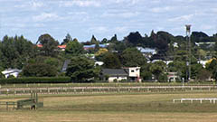
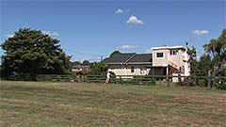
The simple shots (cont….)
EWS
VWS

Slide 13
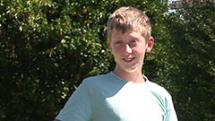
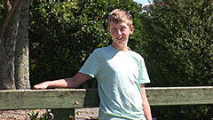
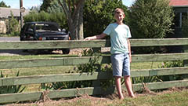
The simple shots (cont….)
MCU
MS
WS

Slide 14
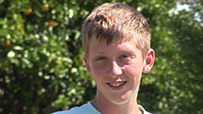
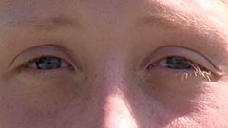
The simple shots (cont….)
CU
ECU

Slide 15
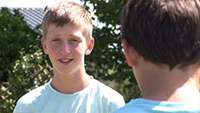
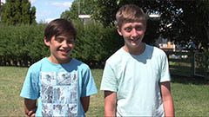
The simple shots (cont….)
OSS
2 S

Slide 16
The complex shots
A complex shot may contain one or more people or things
Lens ,camera and subject movement. no mount movement
A pan
A tilt
A pan and tilt
A lens movement(a focus pull or a zoom)
A lens movement and a pan
A lens movement and a tilt
A subject movement and a pan
A subject movement and a tilt

Slide 17
The developing shots
A lens ,camera ,camera mount and a complicated subject movement
Static beginning and static ending

Slide 18
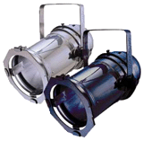
lighting
Lighting means control of light and shadow. Both are necessary to show the shape and texture of a face or object.
Quality of light
Directional and diffused

Slide 19
Quality of light
Directional light
Produced by spotlights ,illuminates a relatively small area with a distinct light beam produces dense, well-defined shadows.
The sun on a cloudless day acts like a giant spot light, producing dense and distinct shadows.

Slide 20
Diffused light
Illuminates a relatively large area with a wide, indistinct beam. It is produced by flood lights and creates soft ,transparent shadows.
The sun on a cloudy or foggy day acts like an ideal floodlight, because the overcast transform s the harsh light beams of the sun into highly diffused light.

Slide 21
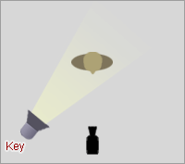
Lighting functions
Key light
Apparent principal source of directional illumination falling upon a subject or an area. It reveals the basic shape of the subject.

Slide 22
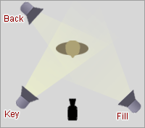
Lighting functions (cont…..)
Back light
Produces illumination from behind the subject and opposite the camera. It distinguishes the shadow of the object from the background and emphasizes the object out line.

Slide 23
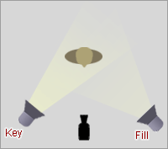
Lighting functions (cont…..)
Fill light
Provides generally diffused illumination to reduce shadow

Slide 24
Lighting functions (cont…..)
Background light / set light
Illuminates the background or the set
Side light
Is placed to the side of the subject
Kicker light
Directional light from the back ,usually from a low angle

Slide 25
Audio.‘sound pick up
The sound portion of television and its production. technically ,the electronic reproduction of audible sound. it transmits information (such as news story),helps establish the specific time and locale of the action ,contributes to the mood ,and provides continuity for the various picture portions.

Slide 26
Pickup patterns
The territory within which a microphone can hear well is called its pickup pattern, its two-dimensional representation is called the polar pattern.
Omni directional microphone hears sounds from all directions more or less equally well.
The unidirectional microphone hears better in one direction

Slide 27
Operational characteristics of microphones
Some microphones are designed and used primarily for sound sources that are moving, whereas others are used more for stationery sound sources.
The mobile microphones include lavaliere, hand, boom, headset and wireless RF (radio frequency) mics.
The stationary microphones include desk, stand, hanging, hidden and long distance mics

Slide 28
Glossary
Frame
The smallest picture unit in film ,a single picture .
Sot
Sound on tape ,the videotape is played back with pictures and sound.
White balance
The adjustments of the color circuits in the camera to produce a white color in lighting of various color temperatures.
Aperture
Iris opening of a lens ,usually measured in f-stops.
F-stop
The calibration on the lens indicating the aperture,or iris opening (and therefore the amount of light transmitted through the lens).the larger the f-stop number ,the smaller the aperture ,the smaller the f-stop number ,the larger the aperture.
Vox/pop
Series of interviews with ordinary people,to sample the public `
AGC(automatic gain control)
An electric circuit that automatically adjusts the loudness of audio signals.

Slide 29
Thank you

